Slide 1



COURSE NAME : BLOCKCHAIN DEVELOPMENT.
GROUP NUMBER : 002.
PROJECT TITLE : BLOCK CHAIN IN HELPING FARMERS
. .
PROJECT SUBMITTED TO :ANNA UNIVERSITY / NAAN MUDHALAVAN
YEAR : ll^{ND} YEAR.
DEPARTMENT :BE(CSE)
SEMESTER : IV SEMESTER
GROUP MEMBERS : R.DHINESH KUMAR(CSE),
S.BOOPALAN(ECE),R.MURUGAN(ECE).
GUIDED BY :E.LAVANYA. AP/IT
SPOC NAME :MR.DURAI KUMAR.HOD/IT

Slide 2

BLOCK CHAIN IN HELPING FARMERS
BY :
R.DHINESH KUMAR
BE(COMPUTER SCIENCE & ENGINEERING
REG :Au510821104004
COLLEGE : GANADIPATHY TULSI’S JAIN ENGINEERING COLLEGE

Slide 3
INDRODUCTION : Blockchain are primarily administered using peer to peer(p2p)computer network for use as public distributed ledgers. To add and validate new transaction blocks, nodes cooperation according to a consensus algorithm protocol. Blockchain may regarded as safe by desgin and serve as an a distributed computing system with strong . Blockchain record are not unchangeable and blockchain forks are conceivable
AGRI

Slide 4
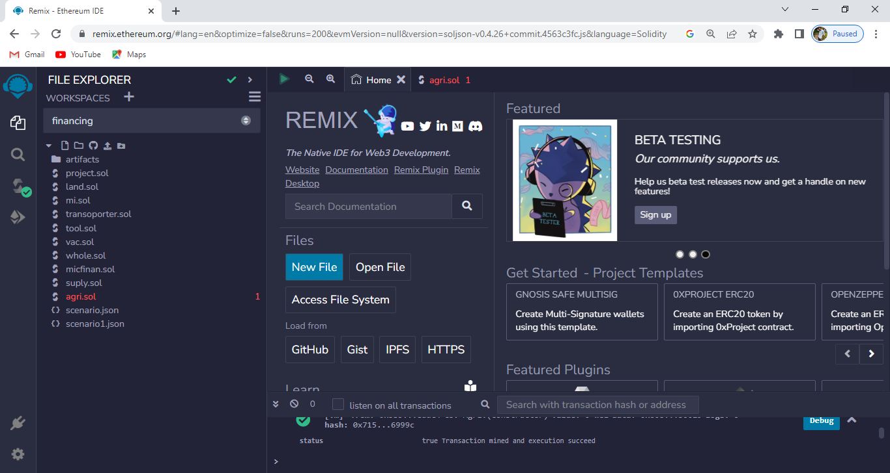
Remix OPEN chrome AND SEARCH REMIX ETHEREUM WEBSITE REMIX PLAYS WELL TO OTHER TOOLS AND ALLOWS A SIMPLE DEPLOYMENT PROCESS TO THE CHAIN

Slide 5
After open the remix IDE, create workspace new and give the workspace name Then select on new file and chick on solity to choose the environment After create a new file , write the program for AGRI application for smart contract using the ethereum blockchain
PROGRAM :

Slide 6
TASK1 : Create a Dapp in remix IDE TASK 2 : Start Metamask Blockchain TASK 3 : Connect remix IDE to Metamask TASK 4 : Deploy dapp to metmask and test the funcation TASK 5 : Interact with block and check the functionalities along with the gas deduction
TASK :

Slide 7
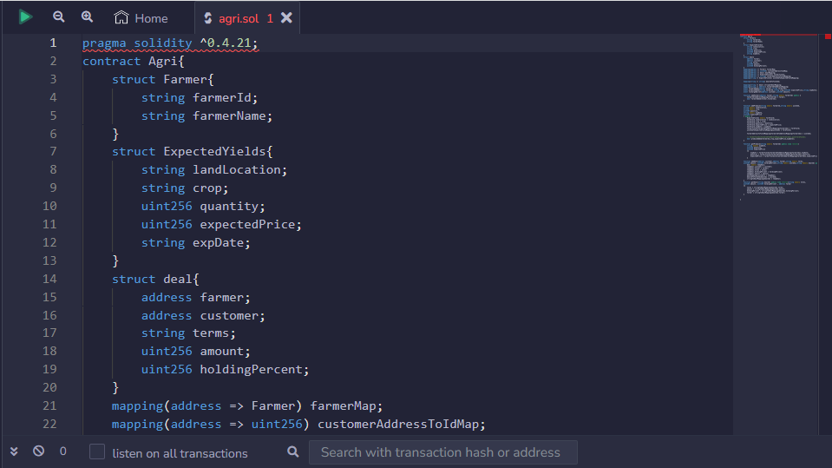
write a program in a code section and click compiler button under the compiler window to compile the contract
PROGRAM :

Slide 8
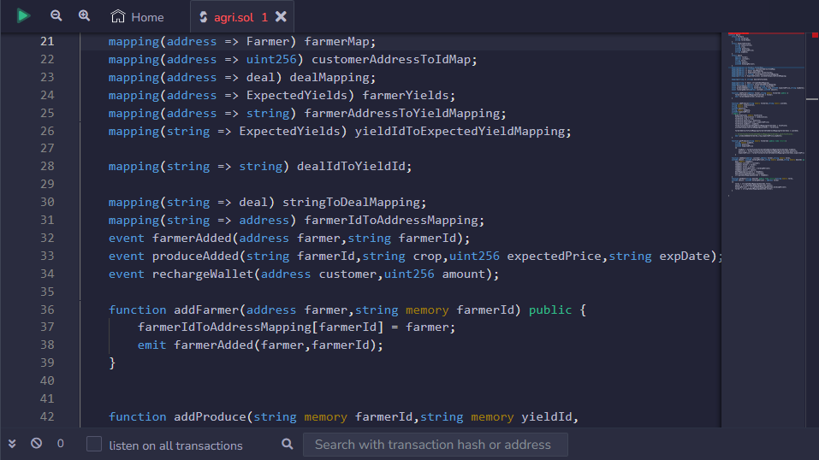
PROGRAM :

Slide 9
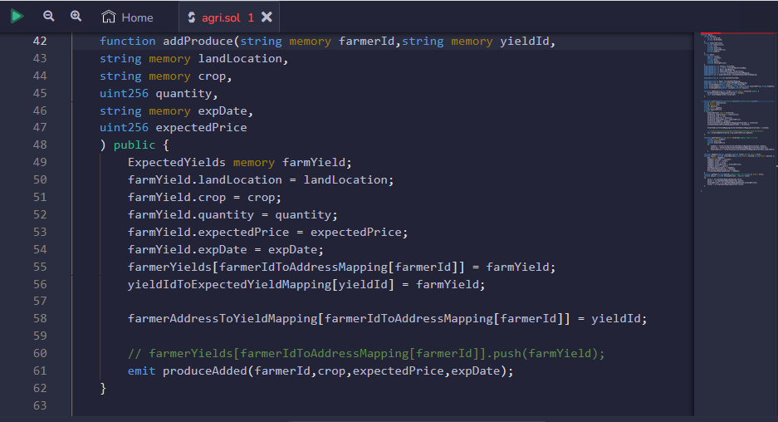
PROGRAM :

Slide 10
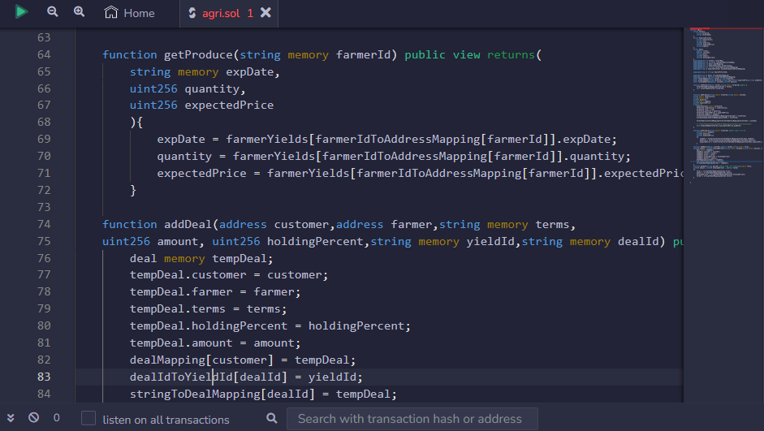
PROGRAM :

Slide 11
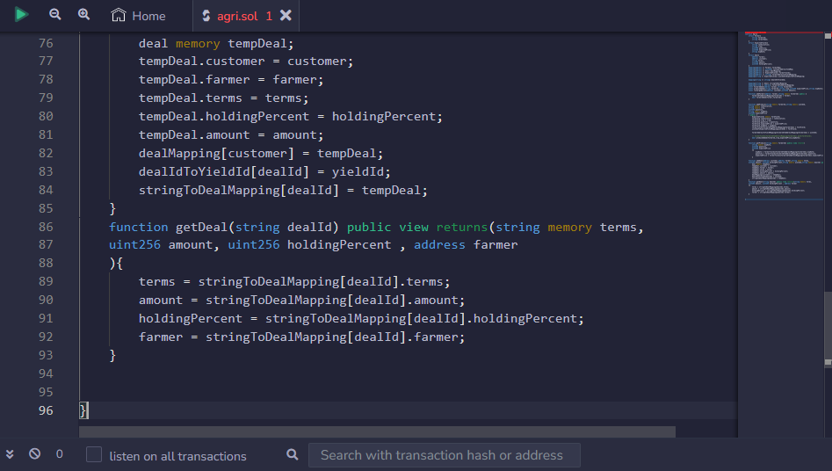
PROGRAM :

Slide 12
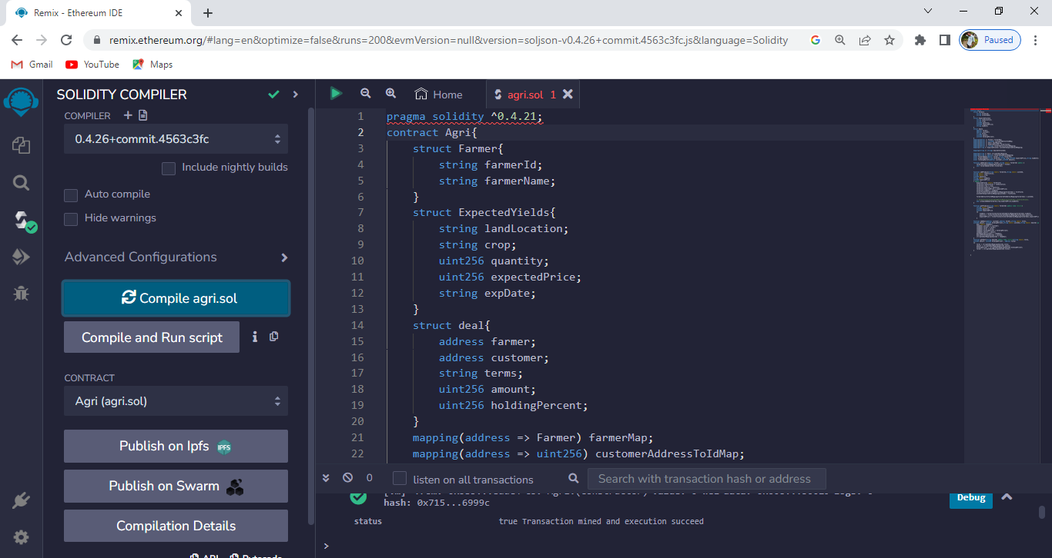
.
PROGRAM :
Then Compile the program and choose the environment

Slide 13
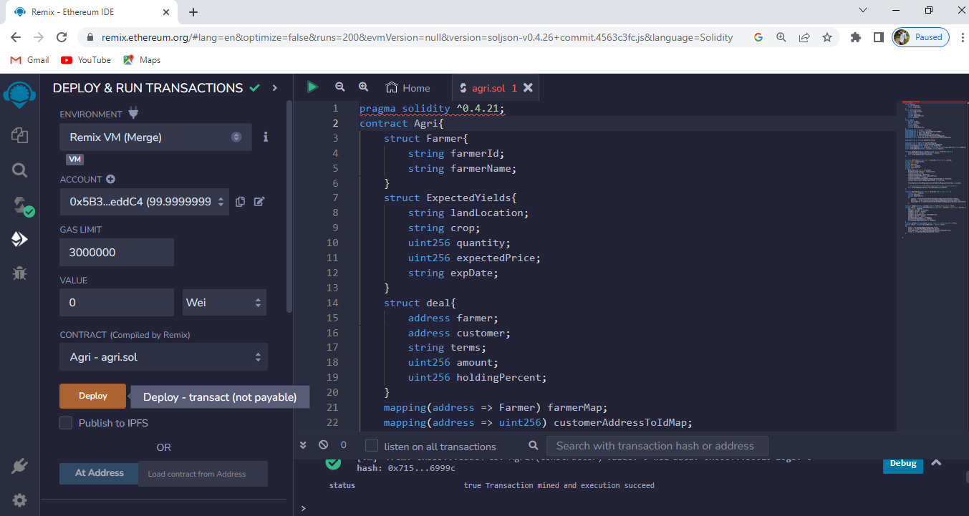
PROGRAM :
After compiling program , then deploy the it

Slide 14

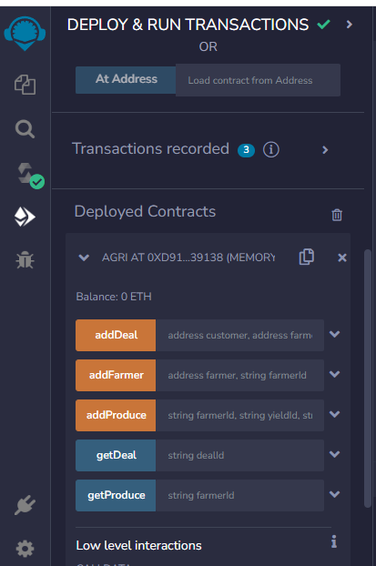
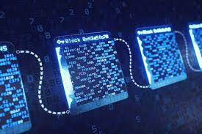
After deploy ,now check the corresponding transaction record will show now(agri)
PROGRAM :

Slide 15
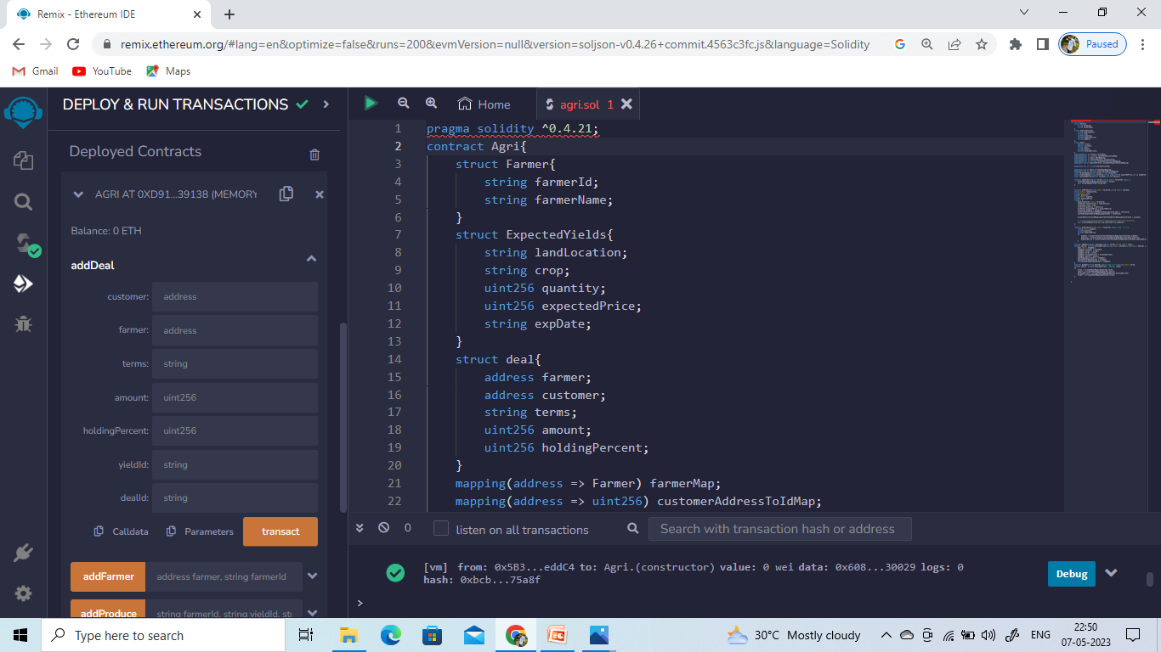
Now open the add Deal in transcation recard
PROGRAM :

Slide 16
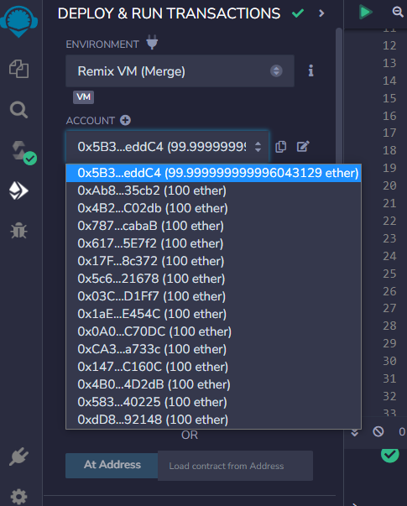
Address will be taken in deploy & run transcation in account address will be copy and paste in customer address
PROGRAM :

Slide 17
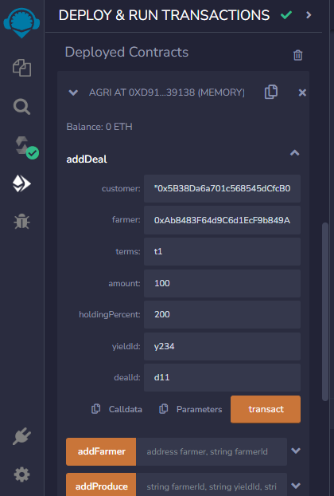
AFTER FILL THE INFORMATION THEN TRANSACT IT.
PROGRAM :

Slide 18

Given information are taken , then can the DEBUG will be green TICK else some mistake will be presented .
PROGRAM :

Slide 19
STEP 1: Open the deployed contract. STEP 2: Give the address both farmer and deals STEP 3: Fill one by one without any unwanted mistake in contract STEP 4: Complete the over all information like add Deal , add Farmer , add Produce , get Deal and get Produce and finally select the transcat
STEP TO DEPLOYED CONTRACTS :

Slide 20
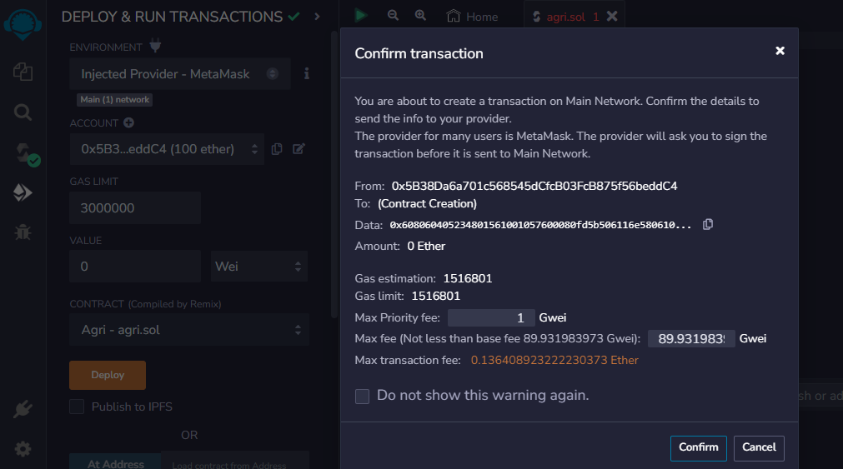
Confirm transaction details then deploy

Slide 21
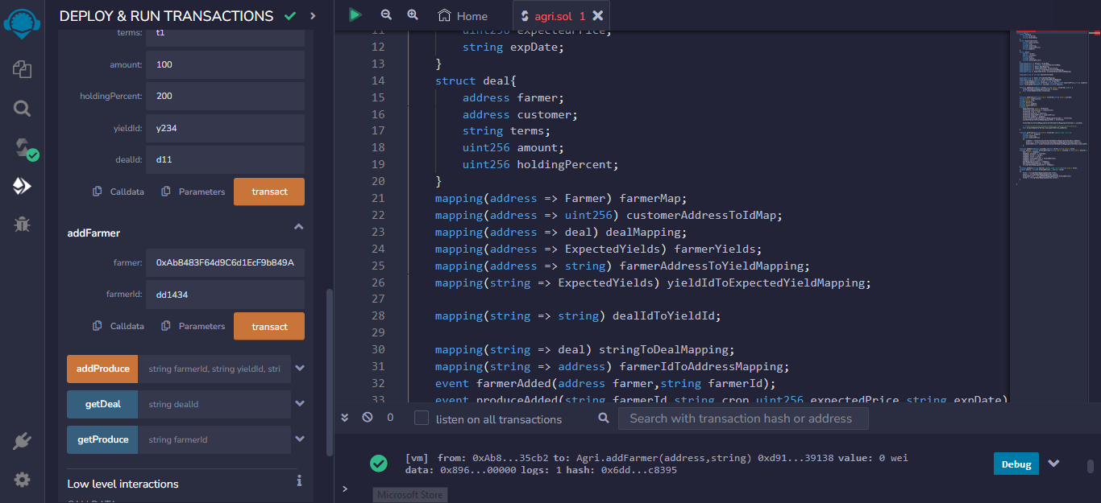
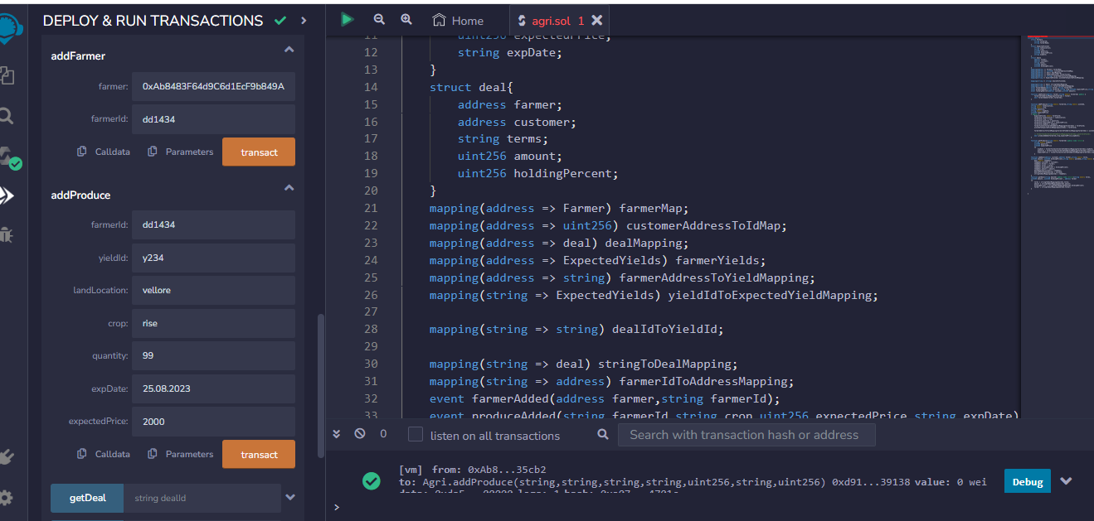
PROGRAM :
Now select the another account and paste in recipient address

Slide 22
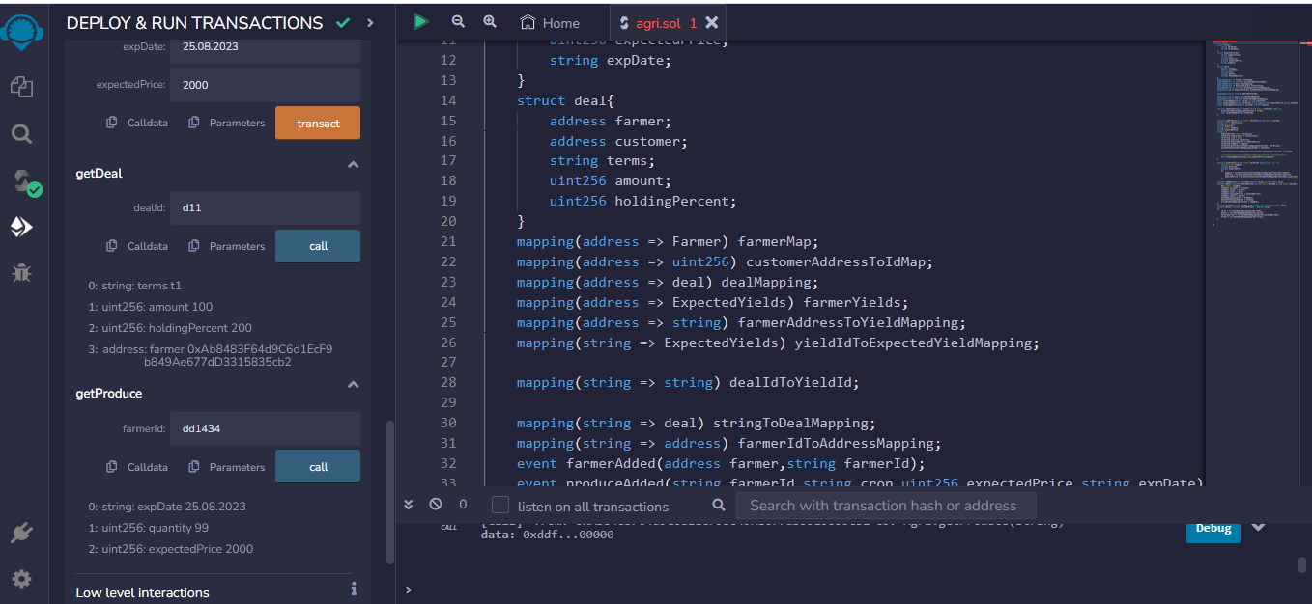
Deals information:
PROGRAM :

Slide 23
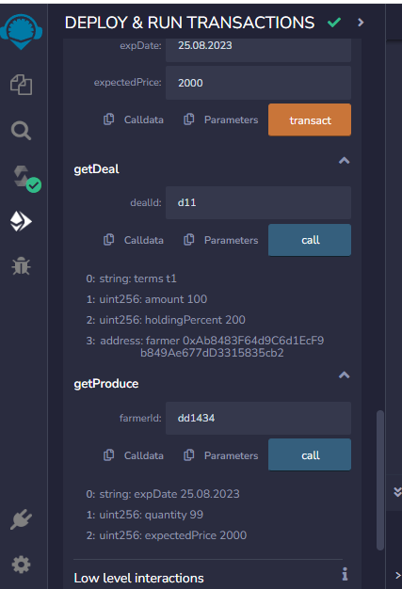
PROGRAM RESULT:

Slide 24
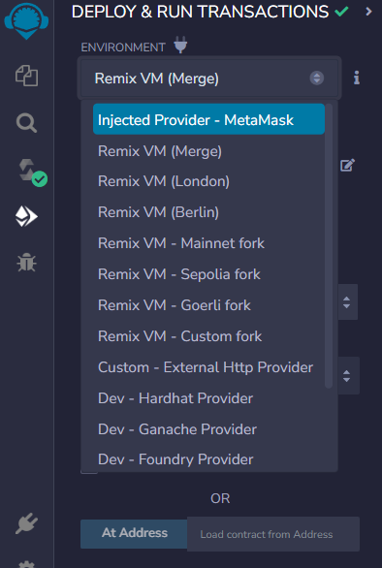
CONNECT REMIX IDE TO METAMAK

Slide 25
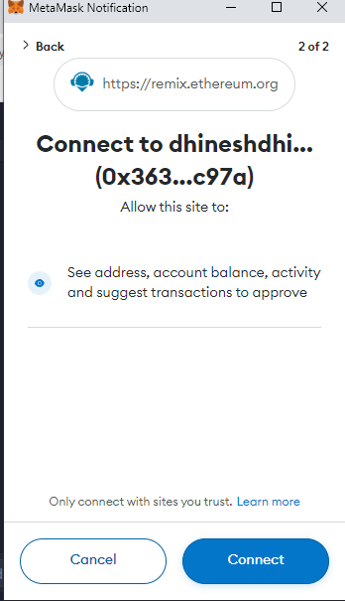
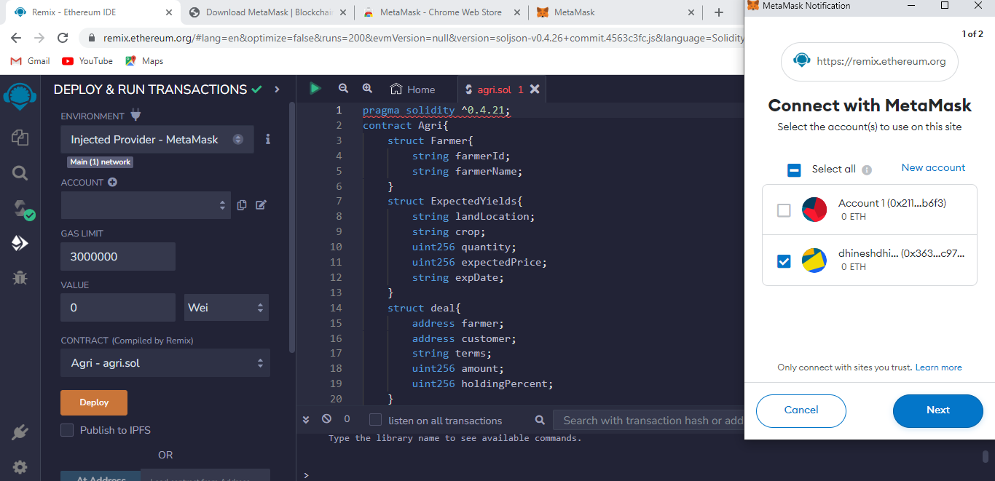
Connected to metamask
CONNECTING WALLETS

Slide 26

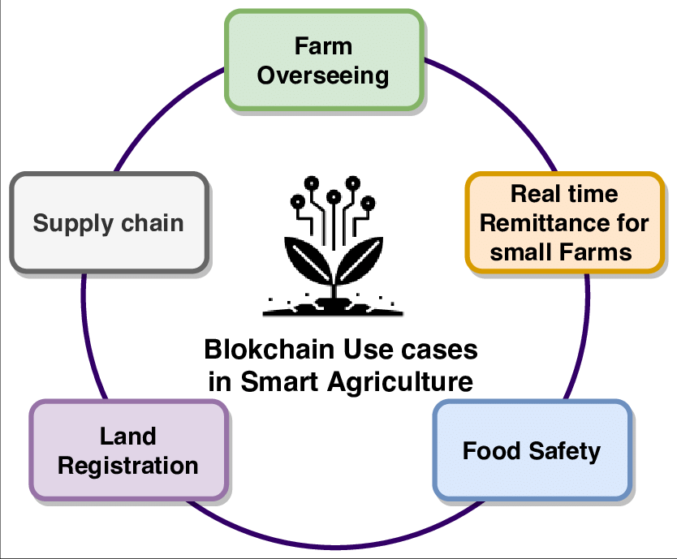
CONCLUSION :
We implement a blockchain-based solution for inventory sharing betweeen retails and suppliers Our propsed solution captures the main interactions that take place between these stakeholders.

Slide 27


